Slide 1
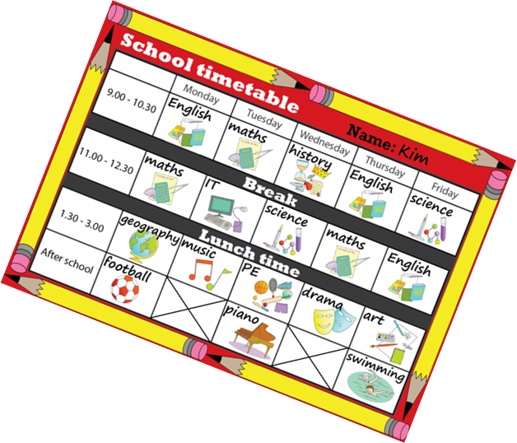
My timetable
Шалкевич Ольга Юрьевна,
учитель английского языка
ГУО «Гимназия №6 г.Минска»

Slide 2
Welcome to the lesson!

Slide 3
How are you today?
naughty
sleepy
happy
sad
angry
upset

Slide 4
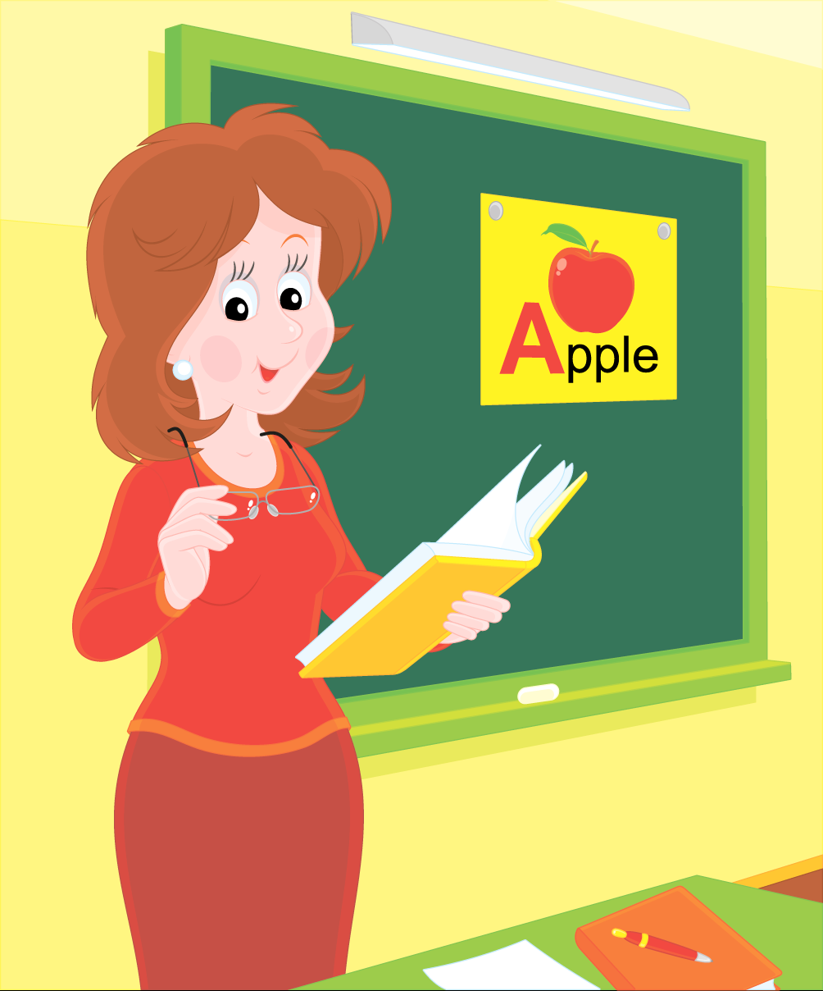
Let’s revise our questions! Listen to me and answer them!

Slide 5
What day is it today?
Do you go to school on Sunday?
How many lessons do you have on Tuesday?
Do you have Art on Thursday?
What lessons do you have today?
Do you have Russian reading today?
How many English lessons do you have?
Do you like PE?
How many lessons do you have on Friday?
What lessons do you have on Wednesday?
Do you have Maths every day?

Slide 6
Let’s check up your homework!
Read the chant (PB, p.73. ex.1a)!
I’m number one, I’m the first!
I’m number three, I’m the third!
I’m number five, I’m the fifth!
I’m number two, I’m the second!
I’m number four, I’m the fourth!
I’m number six, I’m the sixth!
One – the first! Two – the second! Three – the third!
First! Second! Third!
Four – the fourth! Five – the fifth! Six – the sixth!
Fourth! Fifth! Sixth!

Slide 7
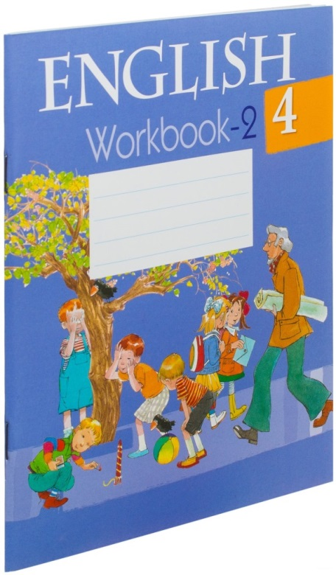
Let’s check up your homework!
Please, swap your WBs in pairs.
p.64, ex.1
Look at the board and check the numbers.
p.64, ex.3
Read the statements and correct the wrong sentences.

Slide 8
Guess the name of our topic!
the first letter in “Maths”
the seventh letter in “Tuesday”
the last letter in “Art”
the third letter in “Friday”
the first letter in “Music”
the second letter in “Reading”
the third letter in “Saturday”
the sixth letter in “Russian”
the first letter in “Belarusian”
the fourth letter in “English”
the second letter in “Technology”
M
y
t
i
m
e
t
a
b
l
e

Slide 9
Work in Grammars!
p.64, ex.165
Look at the timetable and complete the sentences.
p.64, ex.166
Fill in the ordinal numerals. Look at the model.

Slide 10
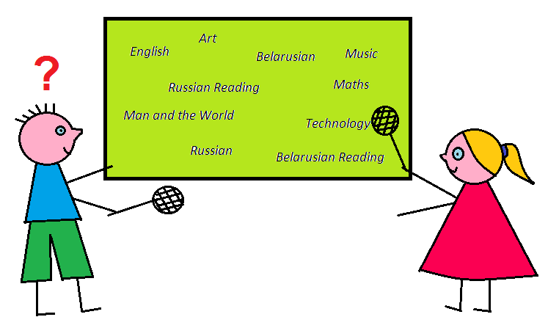
It’s time to play!
We learn about nature in …
We count in …
We sing songs in …
We draw in …
We paint in …
We make things in …
We solve problems in …
We speak English in …
We read Belarusian stories in …
We speak and write Russian in …
We run and jump in …
We play football in …
We listen to music in …
We write Belarusian in …
We read Russian stories in …
Split in 2 teams. Take the flappers. I read what we can do in the lessons, you guess the lesson and touch it.

Slide 11
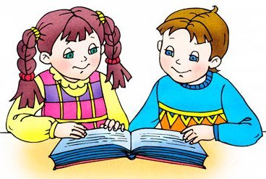
Work in pairs!
Make riddles about lessons.
Model:
A: We listen to stories, read, learn new words, play games and speak English.
B: It’s English!
A: Yes, it is. (No, it isn’t.)
Help box:
write, play football, do crosswords, sing, draw, listen to music, count, paint, have projects presentations, make things, learn about nature

Slide 12
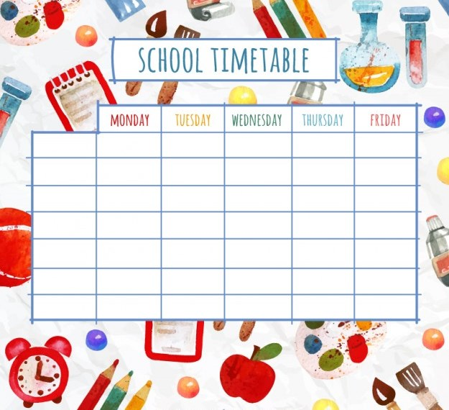
Fill in your own timetable:

Slide 13
Name the adjectives:
interesting
fun
difficult
easy

Slide 14
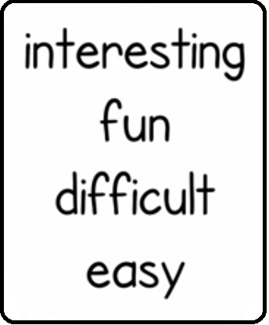
Complete the sentences:
1. I think Art is …
2. I think English is …
3. I think Geography is …
4. I think History is …
5. I think Maths is …
6. I think Music is …
7. I think PE is …
8. I think Science is …

Slide 15
Do you like the lesson?
Yes, I do.
No, I don’t.

Slide 16
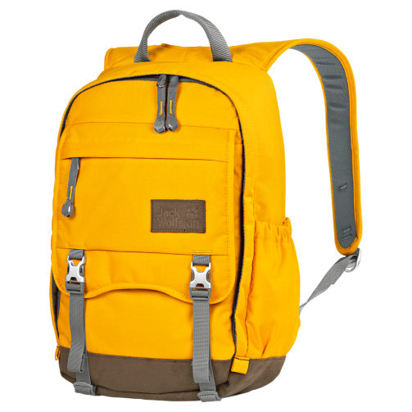
Let’s fill in the schoolbag with the smileys!
If you can speak about your lessons – take a yellow smiley.
If you can’t – take a red one.
If you have questions – take a blue smiley.

Slide 17
Homework:
Gr. p.64, ex.167 (correct mistakes)
WB p.62, ex.2 (draw the way following the [ei]-words)

